Slide 1



SUPERSEDING NOISE THROUGH HASHING AND DATA LINKAGES
National Institute on Aging: Division of Behavioral and Social Research
Advised by Dr. Partha Bhattacharyya
VISHAL DUBEY
Rachel Dodell
Duke University
CS + Statistics

Slide 2




CURRENT PROBLEM
Datasets are linked across across different entities and sources [1]
Errors in identifying the same subjects occur
For example, Paul C. Smith and Paul D. Smith could be linked due to errors in name, among others such as in DOB (Date of Birth)
Lack of fully identifiable information
inherent noise and randomness
Dataset 1
Dataset 2
Dataset 3
Merged Dataset
Notes:
No current general consensus on which hashing approaches provide the lowest error rate and highest rate of consistent linkages across a noisy dataset.

Slide 3
SOLUTION
Created hash value to mask the identifiable data in reproducible way
Created a synthetic and realistic dataset to conduct linkage comparisons
Merged CRISP Legacy Data of NIH awards from the online available datasets for the past 39 years
Approximately 2.1 million data points and 300,000 unique persons
2. Imputed values
MOB, YOB, DOB, Gender [3], Location-specific [4]
3. Adding noise
Key-stroke, gender, zip-code based, MOB/DOB/YOB-errors
Notes:
Don’t spend much time here

Slide 4
TOKEN ANALYSIS STEPS
Matched hashed tokens from a Private Contractor and an internal SHA-512 Hashing Algorithm with known unique identifiers [5]
Grouped results by the hashed token groups and unique identifiers (SSN)
Matched within dataset containing noise encodings (i.e. where exactly noise was imputed)
Counted misses where the SSNs did not result in a match
Repeated Steps 1-3 for results for many permutations of token groups for both SSN and SSN4
Notes:
To identify errors in matching

Slide 5
COMPARISON OF RESULTS
Token | Token Grouping | Private Contractor |  | SHA512 Hash
 |  | Misses | % Incorrect | Misses | % Incorrect
1 | SSN | 0 | 0 | 0 | 0
2 | SSN4 | 11075 | 3.67 | 11052 | 3.66
3 | SSN + MOB + DOB + YOB | 0 | 0 | 0 | 0
4 | SSN4 + MOB + DOB + YOB | 6738 | 2.23 | 6738 | 2.23
5 | SSN4 + Gender + MOB + DOB + YOB | 4739 | 1.57 | 4739 | 1.57
6 | SSN4 + First Name + Last Name | 229 | 0.08 | 229 | 0.08
7 | Last Name + First Name + Gender | 72184 | 23.92 | 72260 | 23.94
8 | Last Name + First Name + Gender + DOB | 7054 | 2.34 | 7079 | 2.35
9 | Last Name + First Name + MOB + DOB + YOB | 46 | 0.02 | 46 | 0.02
10 | Last Name + First Name + Gender + COB | 18584 | 6.16 | 18828 | 6.24
11 | Last Name + Gender + MOB + DOB + YOB + COB | 18 | 0.01 | 18 | 0.01
Note: MOB denotes Month of Birth, SSN4 denotes last 4 digits of SSN, and COB denotes City

Slide 6
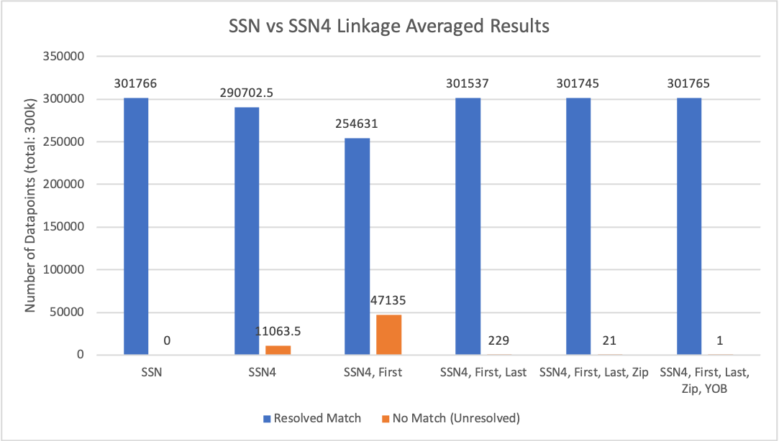
VISUALIZING SSN VS SSN4 HASHING
Notes:
If you have correct SSN across the board, you get perfect matches. Non perfect SSNs (4 digits) introduces problem: can we resolve? (sol: adding parameters in token grouping)

Slide 7
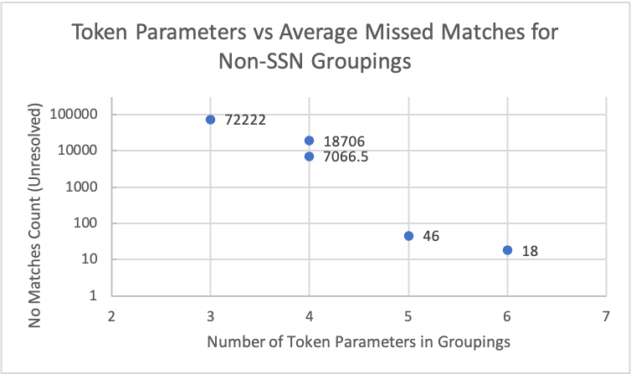
INCREASING PARAMETERS YIELDS BETTER MATCHES
Notes:
If you have correct SSN across the board, you get perfect matches. Non perfect SSNs (4 digits) introduces problem: can we resolve? (sol: adding parameters in token grouping)
QUALITY OF PARAMETERS DRIVE RESULTS: 18000 VS 7000
Briefly mention tradeoff with having too many parameters

Slide 8
DELIVERABLES AND FUTURE WORK
Conclusion
Based on the results from the SHA512 Hash and the Private Contractor, the unresolved miss rates are roughly similar
The SSN4 was a worse indicator of linking on it’s own, but combined with other columns (First Name, Last Name, YOB) it is still formidable
Next Steps
Obtain final hashing results from NIH GUID ID’s and Datavant (January 2021)
Provide final recommendation and comparison on most appropriate hashing approach

Slide 9

SPECIAL THANKS AND CONTACT
Special Thanks to:
NIA: Division of Behavioral and Social Research
Dana Plude
Partha Bhattacharyya
Jonathan King
National Institutes of Health
Jessica Mazerik
Coding it Forward
Rachel Dodell
Chris Kuang
Ariana Soto
Contact Info:
Vishal Dubey
Duke University
Computer Science and Statistics
E: dubeyv2@nih.gov | vishal.dubey@duke.edu
T: (407) 687 - 8998

Slide 10
CITATIONS
[1] An Introduction to Probabilistic Record Linkage (http://www.bristol.ac.uk/media-library/sites/cmm/migrated/documents/problinkage.pdf)
[2] Probabilistic record linkage (https://www.ncbi.nlm.nih.gov/pmc/articles/PMC5005943/)
[3] Gender predictor model (https://pypi.org/project/gender-guesser/)
[4] Zipcode and city database (https://pypi.org/project/uszipcode/)
[5] SHA-512 Cryptographic Hash Algorithm (https://www.movable-type.co.uk/scripts/sha512.html)

Slide 11
APPENDIX
VISHAL DUBEY
Rachel Dodell
Duke University
CS + Statistics

Slide 12
SOLUTION
A hash is a value that masks the original data in an identifiable way so that it may be compressed.
Generated synthetic dataset with imputed noise
Ensures that noise is controlled and known for each variable/column in the dataset
Groupings based on variables where noise was imputed
Analyze differences in hashed values for insight into unresolved versus resolved matches
An analysis of tokens hashed in different pairings to observe how the noise affected the error rates for linkages within a dataset

Slide 13
TOKEN GROUPS
Token | Private Contractor and SHA512 Hashing Token Elements
1 | SSN
2 | SSN4
3 | SSN + MOB + DOB + YOB
4 | SSN4 + MOB + DOB + YOB
5 | SSN4 + Gender + MOB + DOB + YOB
6 | SSN4 + First Name + Last Name
7 | Last Name + First Name + Gender
8 | Last Name + First Name + Gender + DOB
9 | Last Name + First Name + MOB + DOB + YOB
10 | Last Name + First Name + Gender + COB
11 | Last Name + Gender + MOB + DOB + YOB + COB
Notes:
REMOVE

